Slide 1


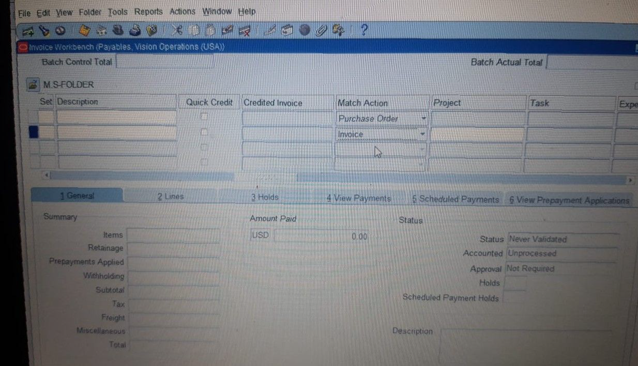
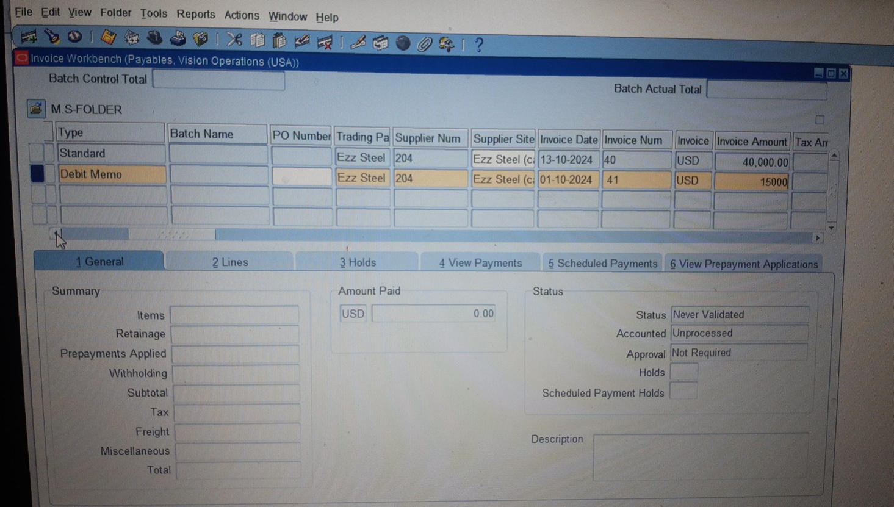
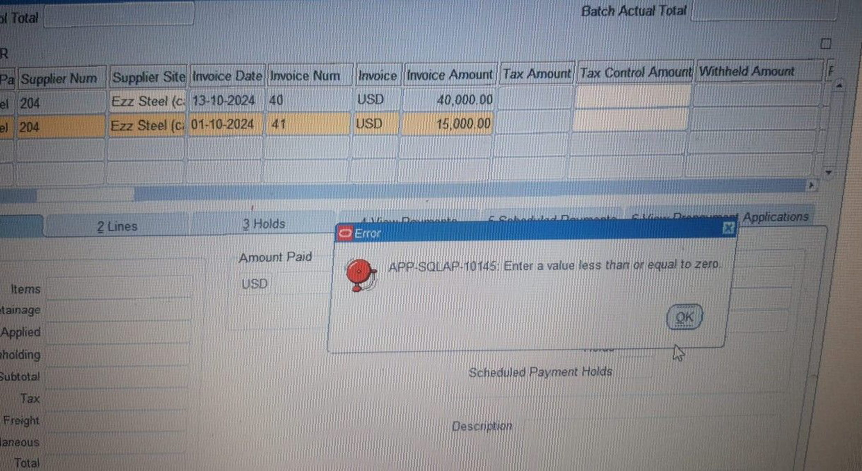
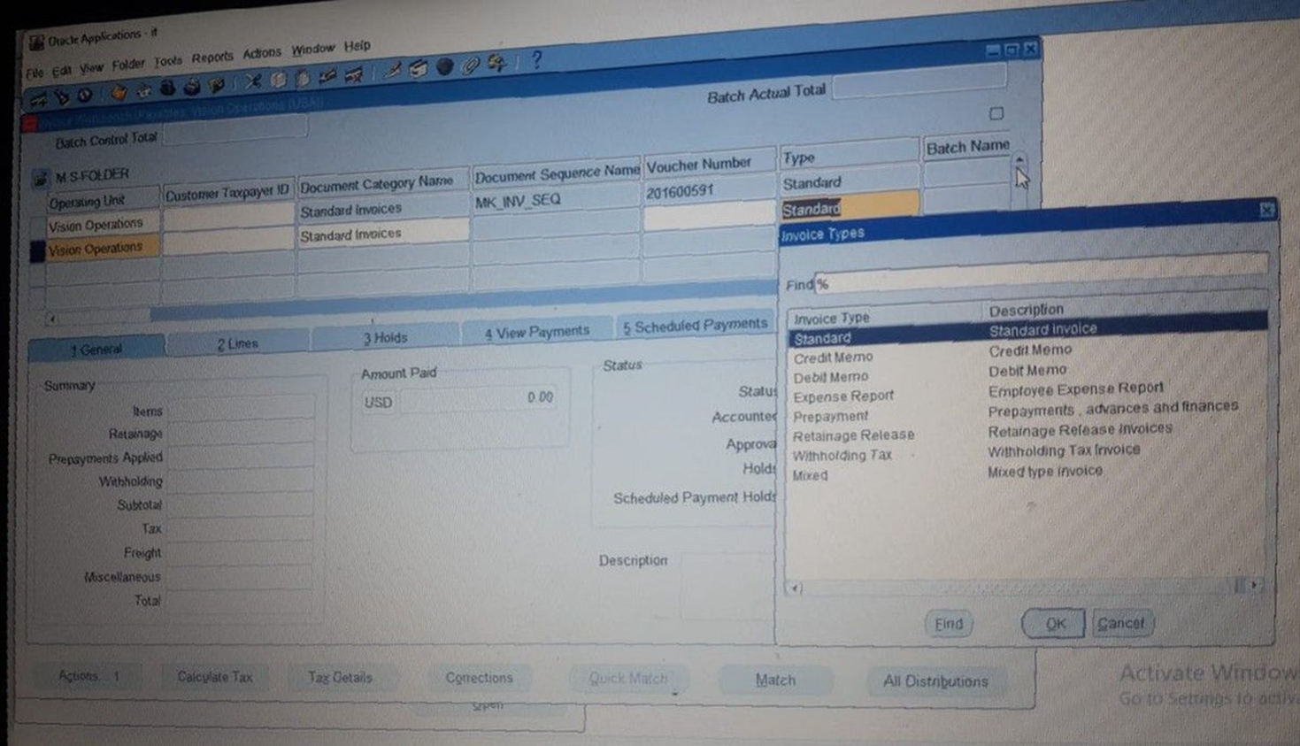
Create and Manage Supplier Invoices
Creating Invoices​
Choose Debt Memo​
Match Action > Invoice> Correction
18
Notes:
Note / The Invoice Amount must be less than or equal zero (Negative Amount )

